Slide 1


Slide 2
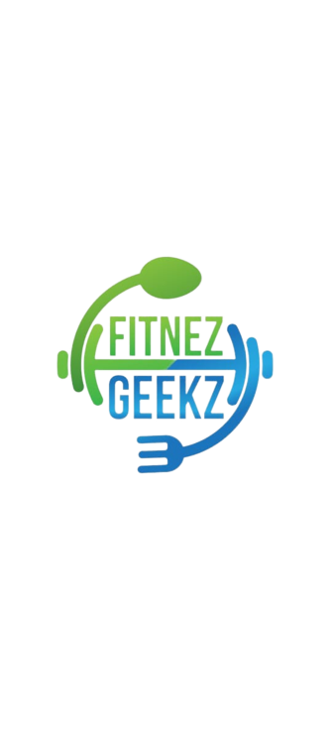
FitnezGeekz
Developed By: Disha Gupta
: Harshvardhan Kale

Slide 3
Introduction
We all have gone or thought about going to the gym once in our life. So, what happens when we go to the gym? In the starting 3-4 days a trainer is always there for us but later they hand over a sheet of paper with workout and diet on it. We can’t refer to it when we are outside the gym in our daily life and know what workout is there or what diet we have to follow. If a trainer is missing we have to look at faces to check our form if it’s correct or not. This app helps with every problem we face in the gym. You can look at the workout and then do it and you have access to diet and workout every time.

Slide 4
What does the App do?
It calculates Your BMI According to your weight.
Displays a Diet and Daily workout for 6 days a week.
Connects you with Trainer on call.
Eliminates the Pen-Paper system from Gym.

Slide 5
Steps to Access the App
Install the App.
Register Yourself as a new User.
From the home page, go to BMI where you can calculate your weight.
After calculating, you will know if you have to gain or lose weight.
After choosing a go-to diet and start following it accordingly.
Also a 6 day workout will be given which you can follow

Slide 6
Business Model
Our main focus will be on the Trainer element.
Eventually we will have a good number of Trainers on our platform and just like other apps like Practo, we will start charging a subscription amount for users to connect with trainers.
Also Trainers will provide more customized diets and workouts if the user needs them, the same will come under a subscription model.

Slide 7
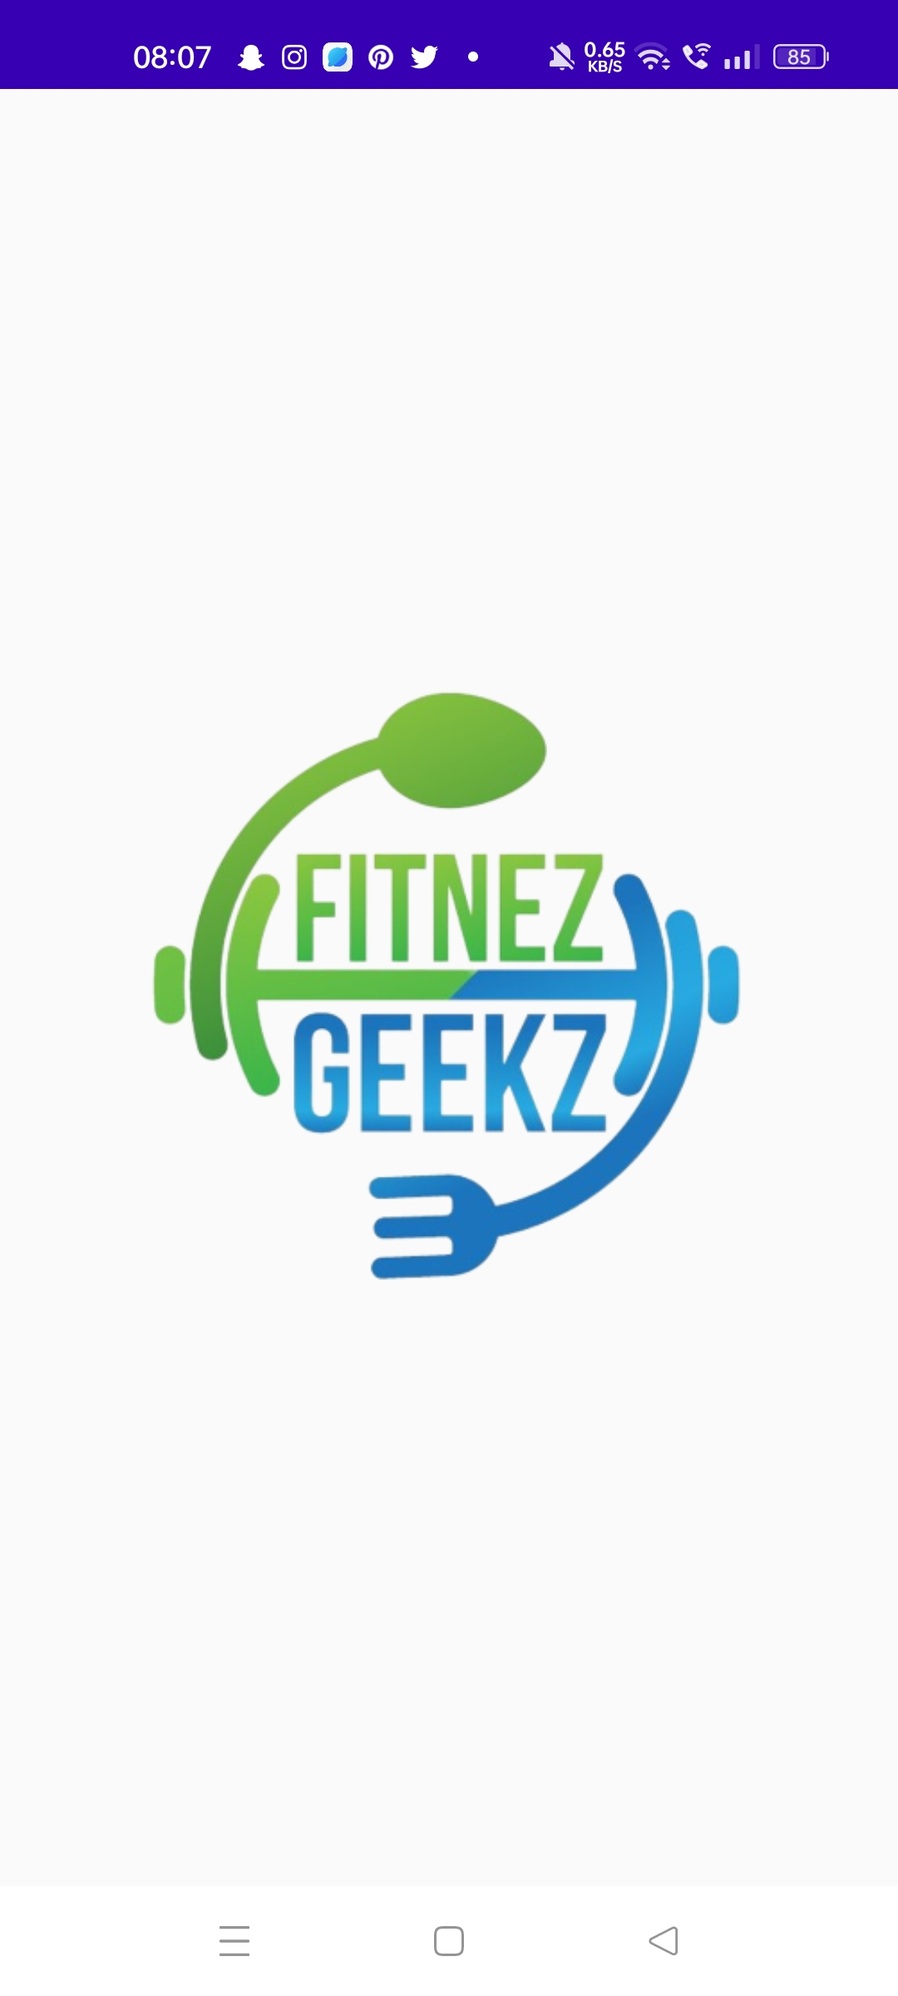
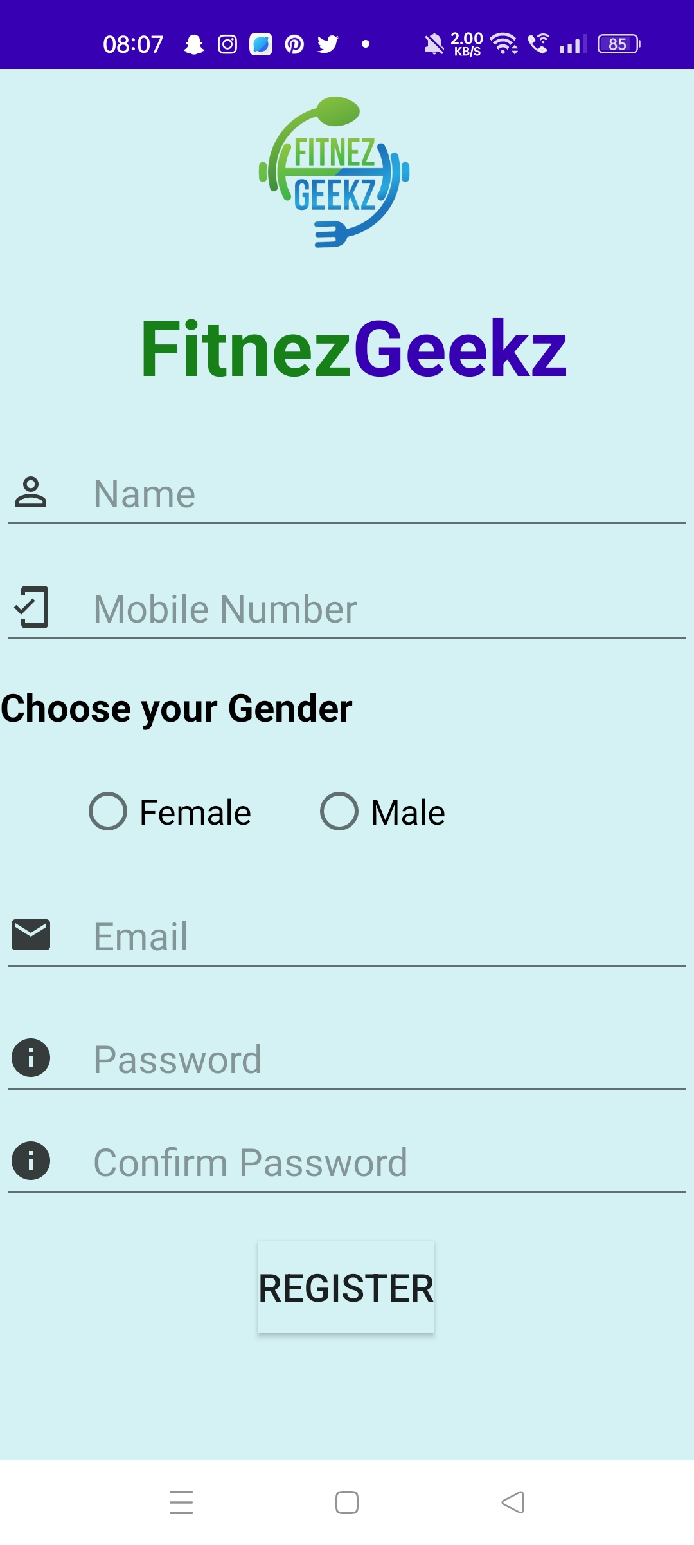
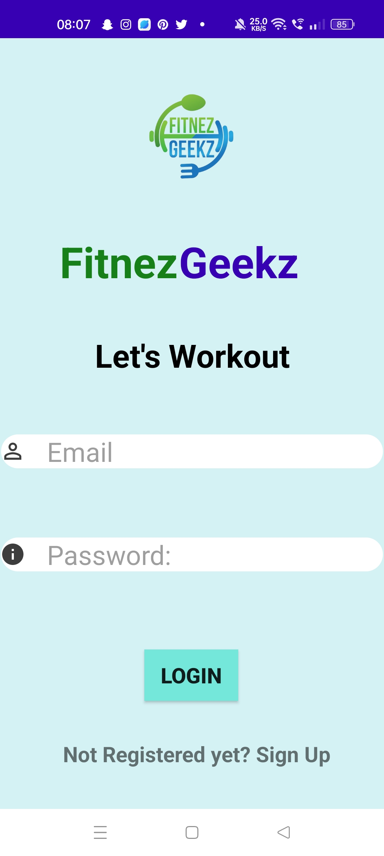
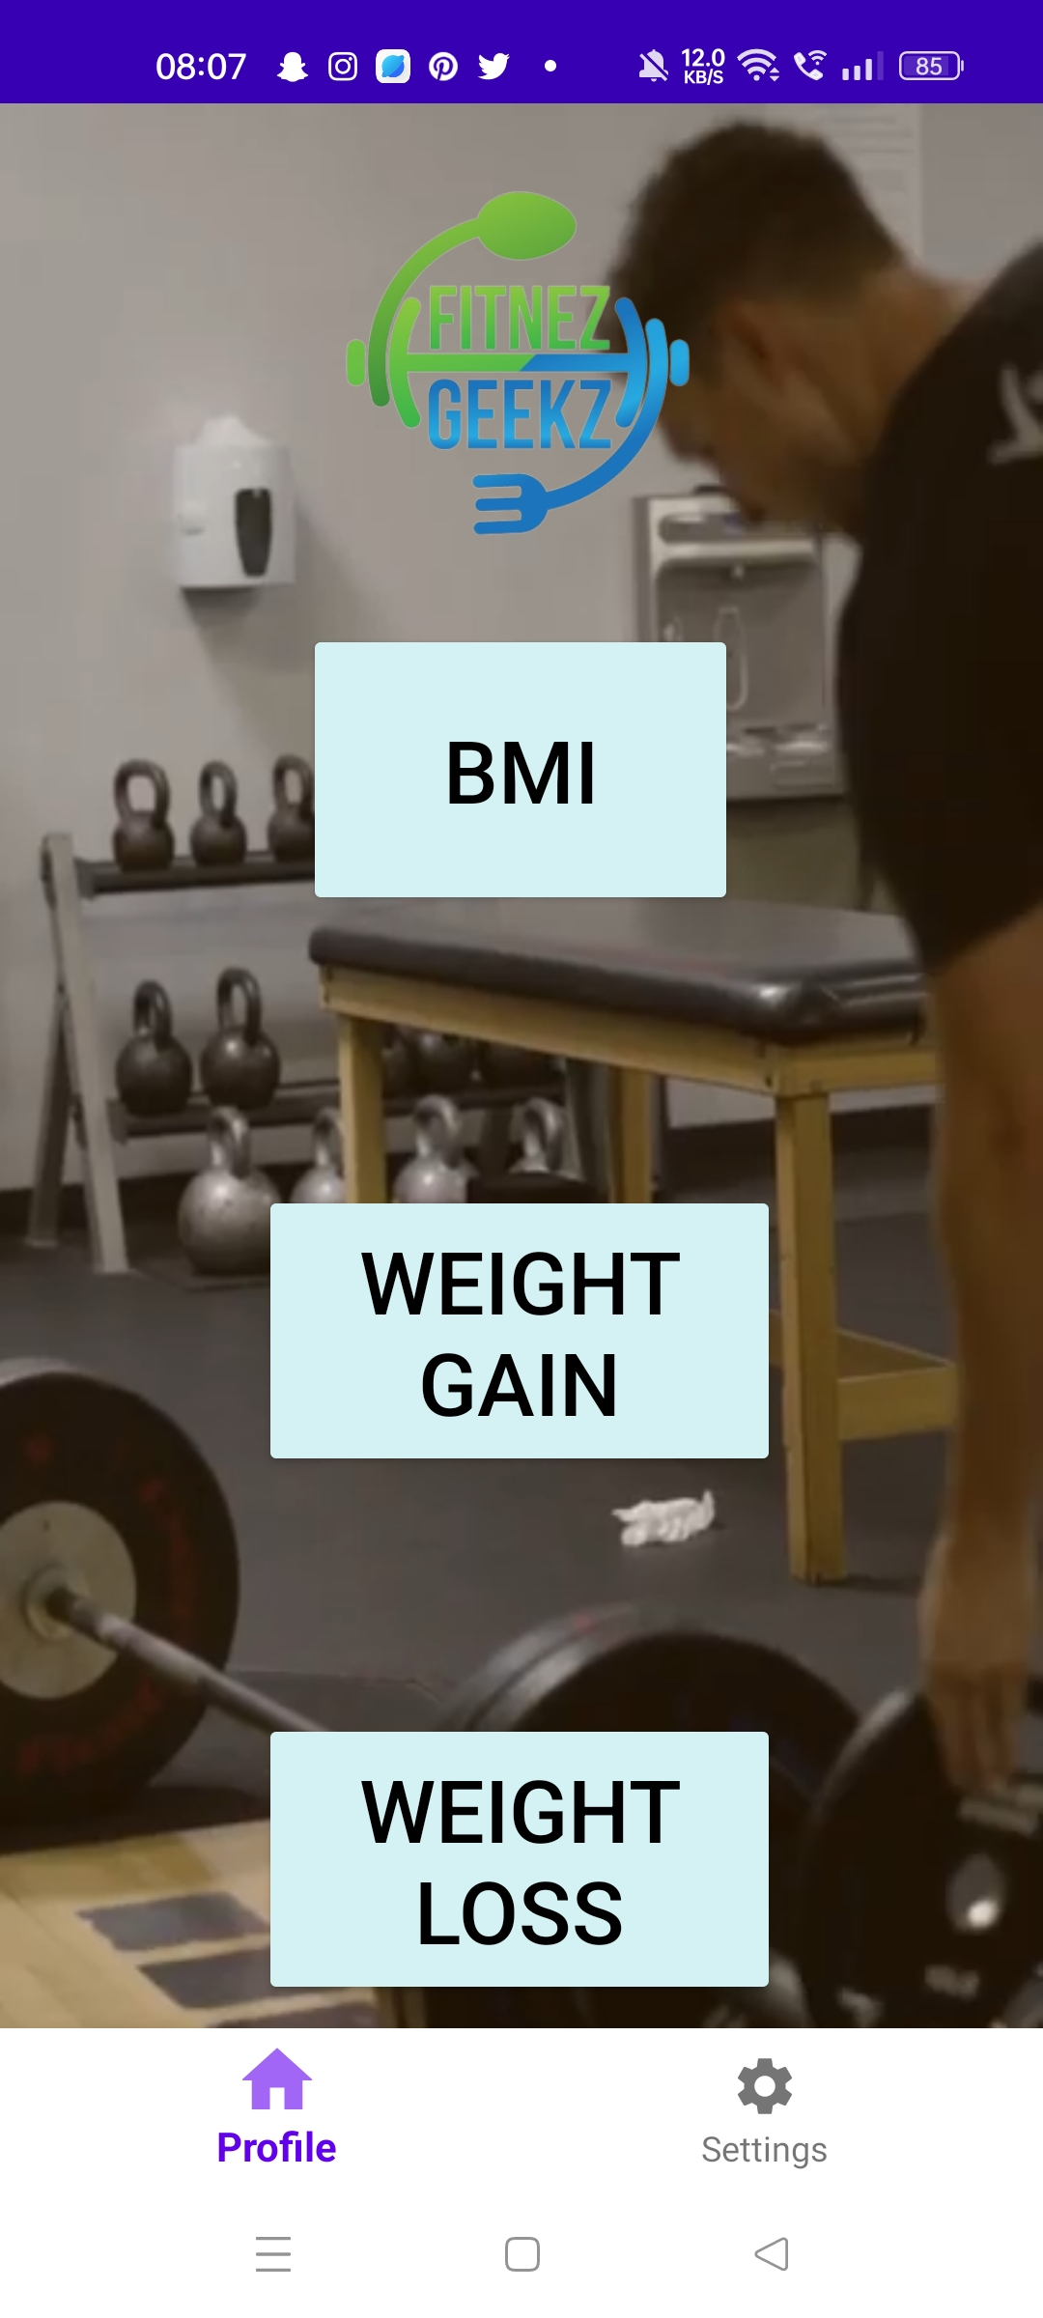
Snapshots of our App

Slide 8
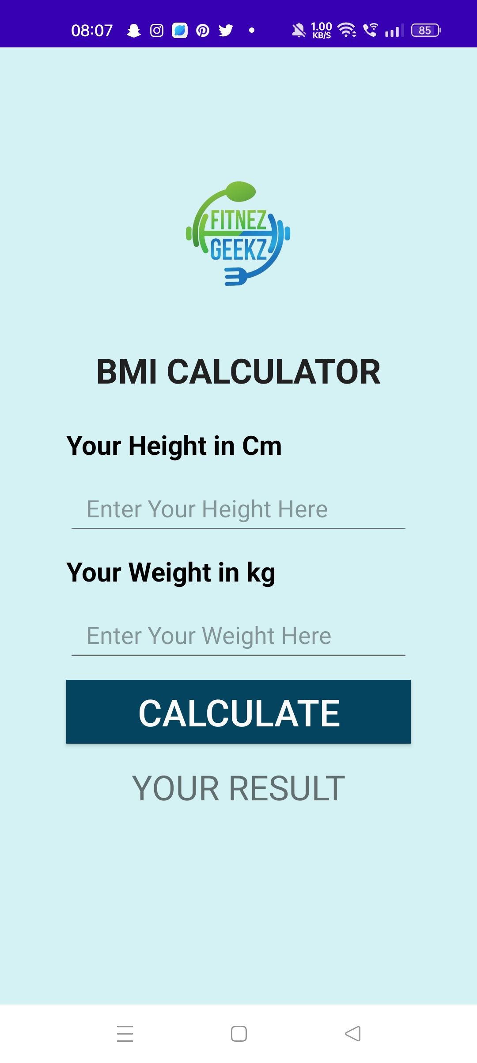
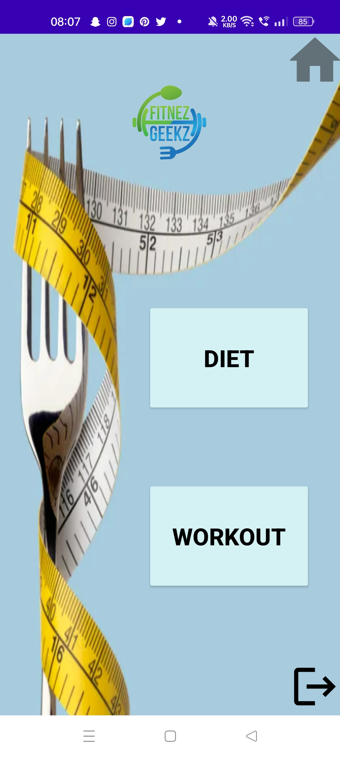
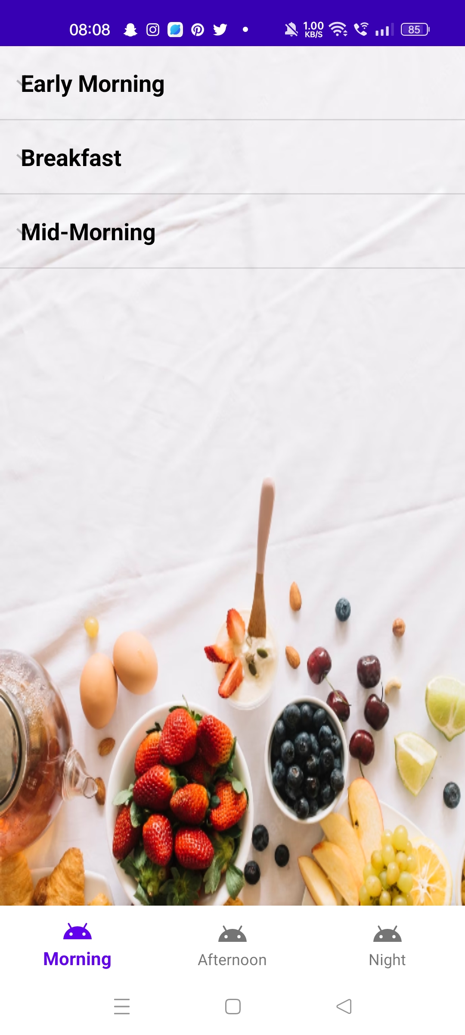
Snapshots of our App

Slide 9
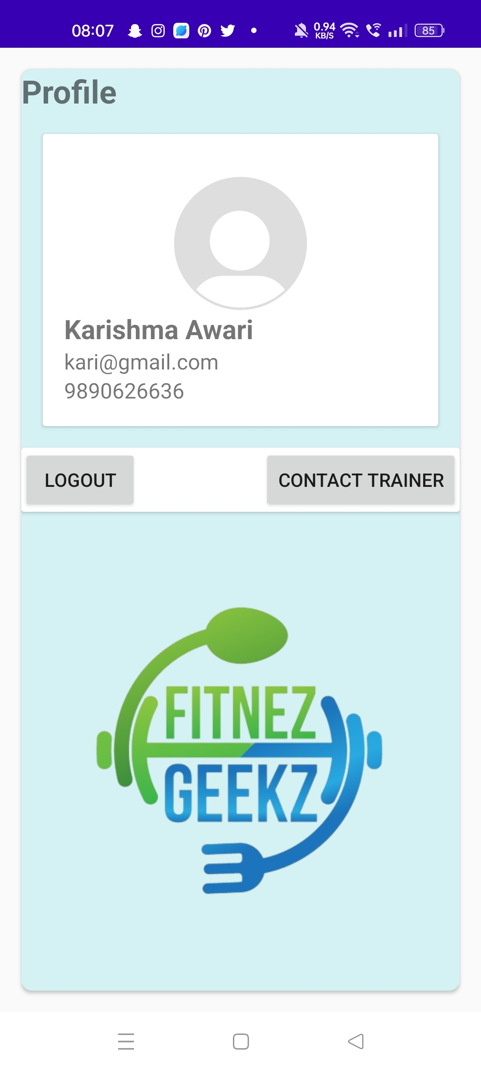
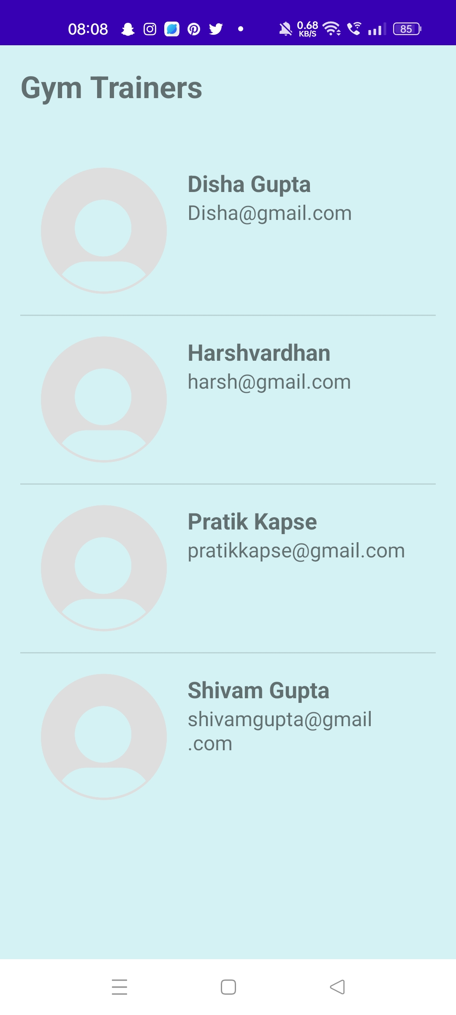
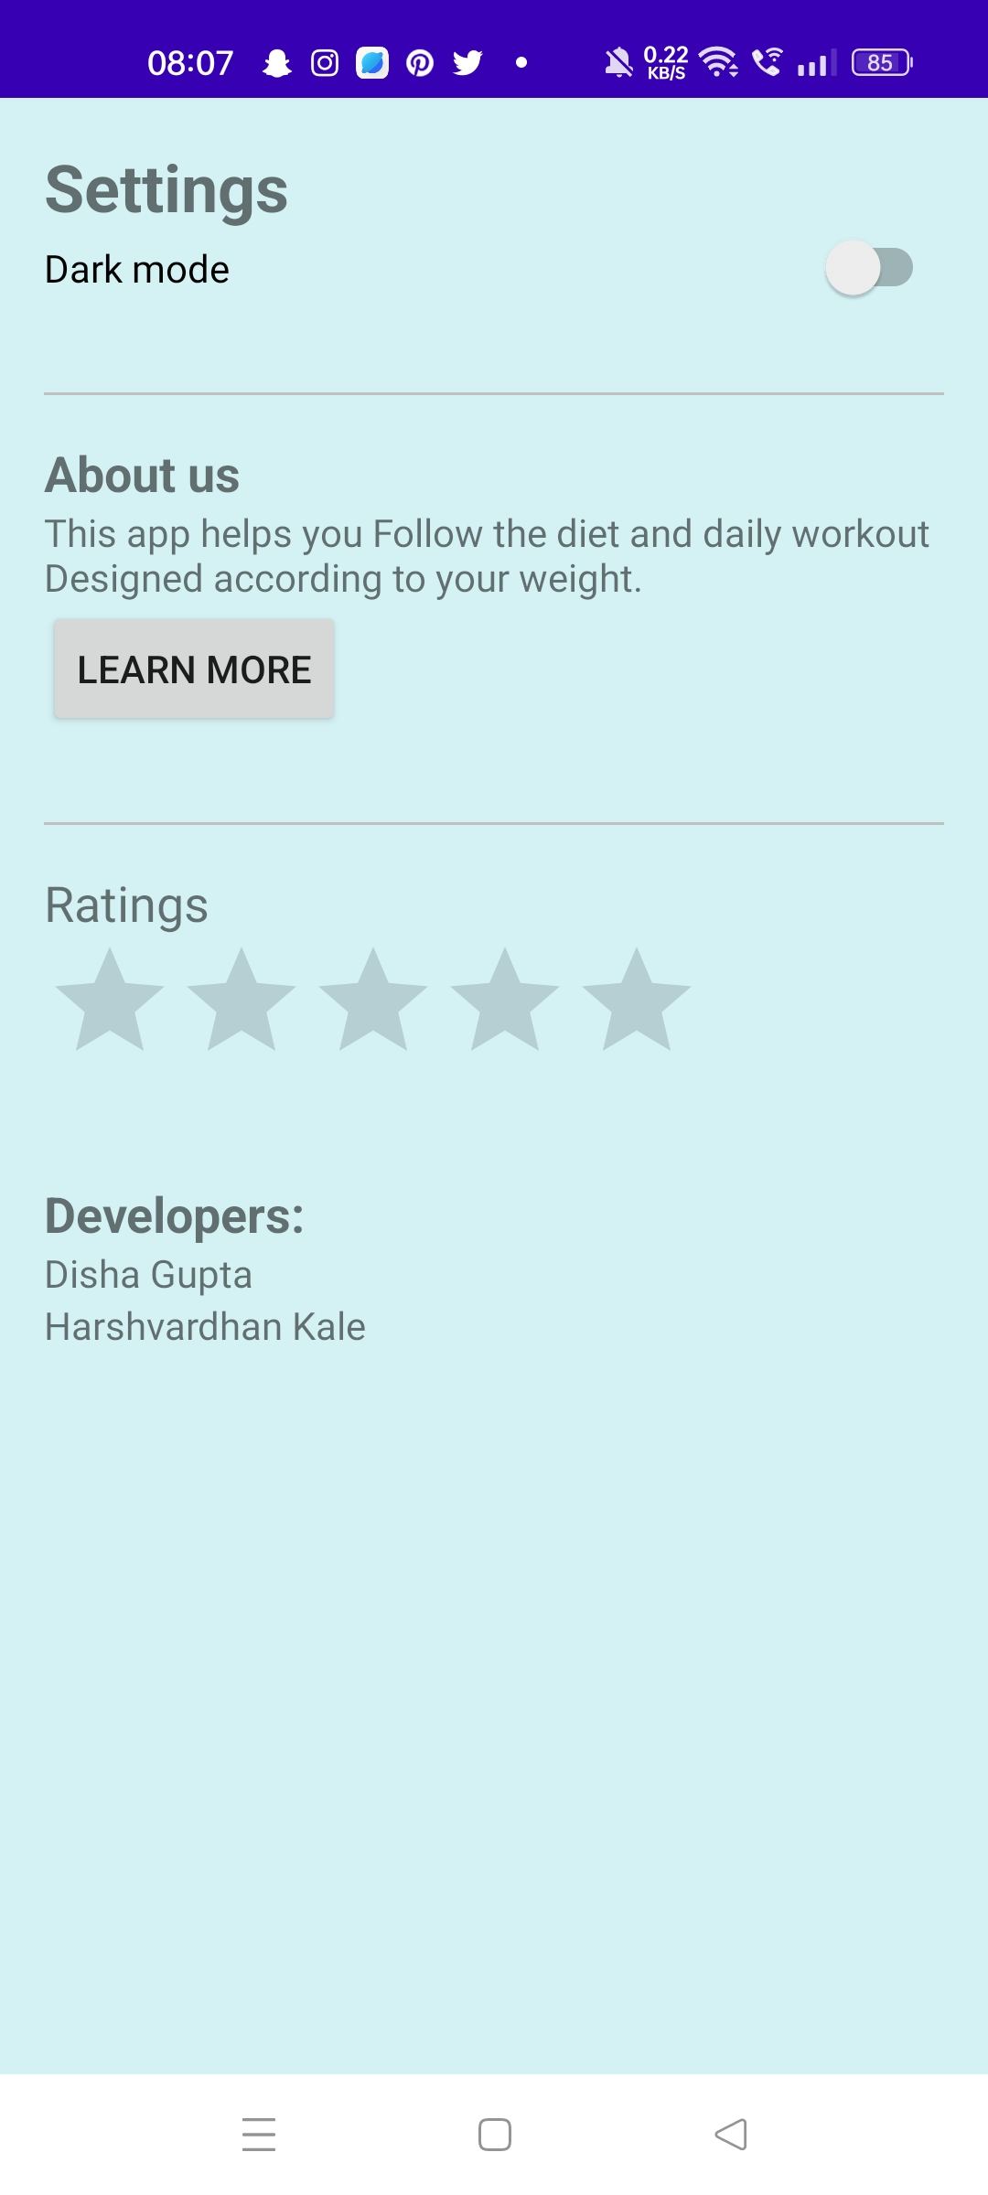
Snapshots of our App

Slide 10
Any Questions?

Slide 11
Let’s begin Your fitness journey with FitnezGeekz

